Slide 1
FHO5000 PRO Improvement
PRO version serial number start with E5FHA2xxxx
1: Dynamic range improvement
2: Deadzone optimization
3: FLM(Fiber linke map) performance optimization
4：Add some New functions

Slide 2
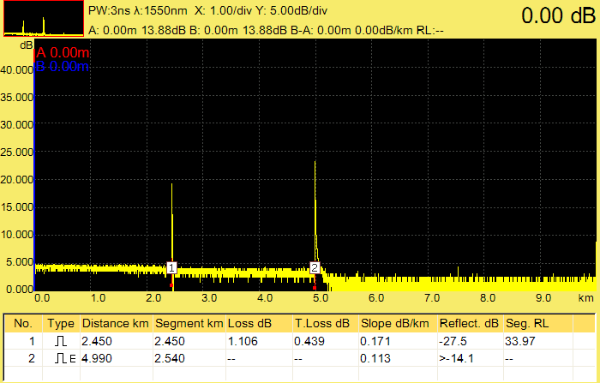
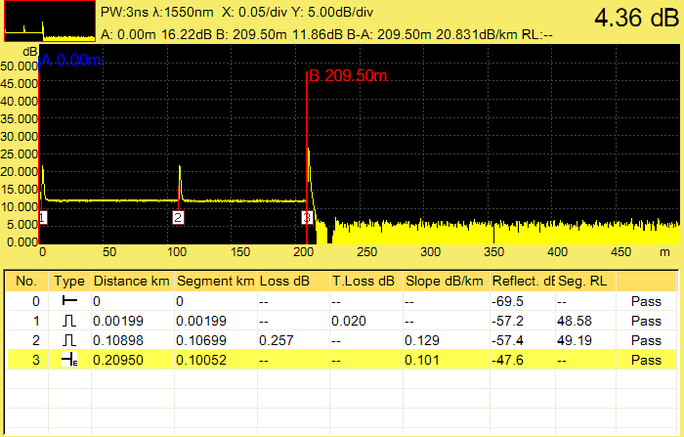
1：Dynamic range improvement
Based on the improvement of hardware circuits and APD circuits, the dynamic range performance of (3ns-20us) has been comprehensively improved, especially with significant improvement in small and medium pulse width dynamics. (for example: OTDR can have 7dB dynamic even at 3ns)
old version at 3ns
new version at 3ns

Slide 3
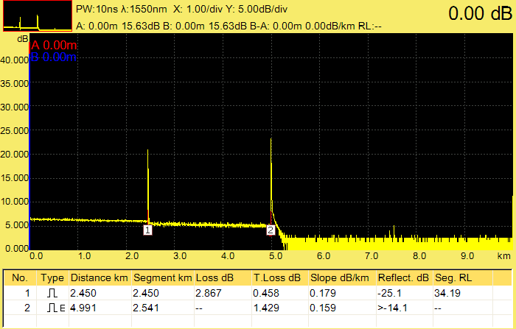
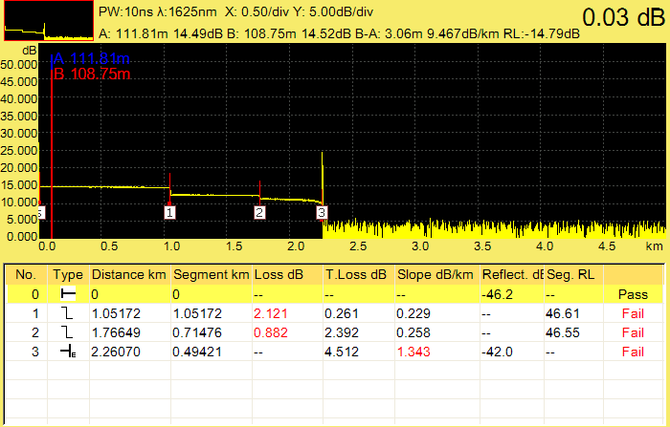
1：Dynamic range improvement
old version at 10ns
new version at 10ns

Slide 4
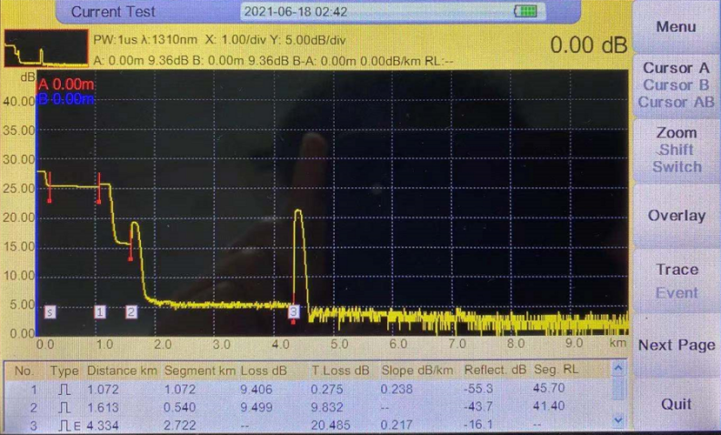
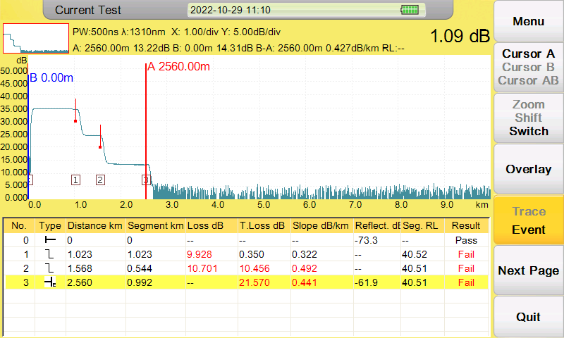
1：Dynamic range improvement
old version at 1us
new version at 500ns

Slide 5
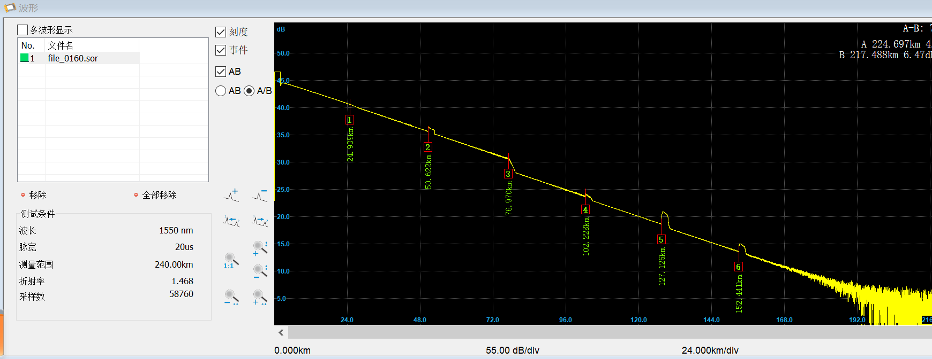
1：Dynamic range improvement
old version at 20us
new version at 20us

Slide 6
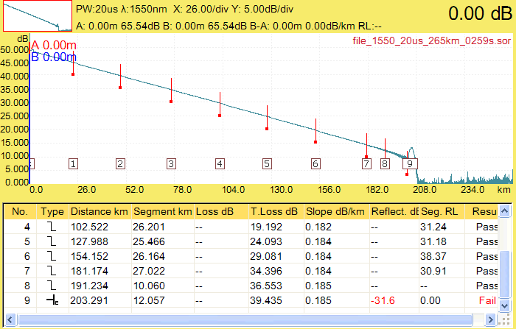
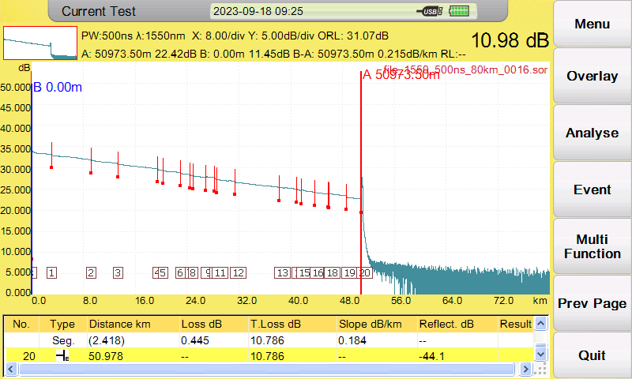
1：Dynamic range improvement
200km fiber optic measurement in lab environment (FHO5000-D45PRO)
50km fiber optic measurement with 500ns in field
(FHO5000-D45PRO)

Slide 7
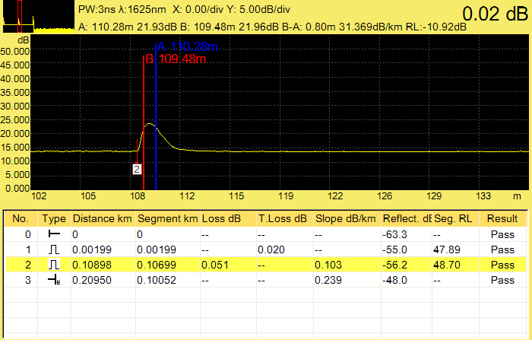
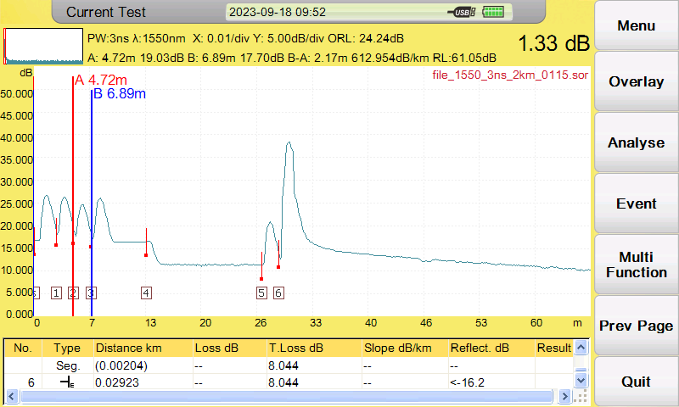
2: Deadzone optimization
New Event deadzone：<0.8m
New attenuation deadzone：<3.5m
⭐Easy detection of 2 meters continuous patchcord
and fiber attenuation within 10 meters

Slide 8
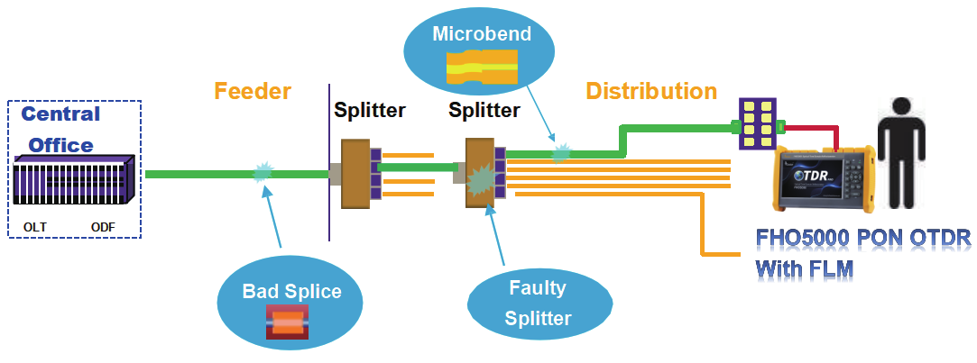
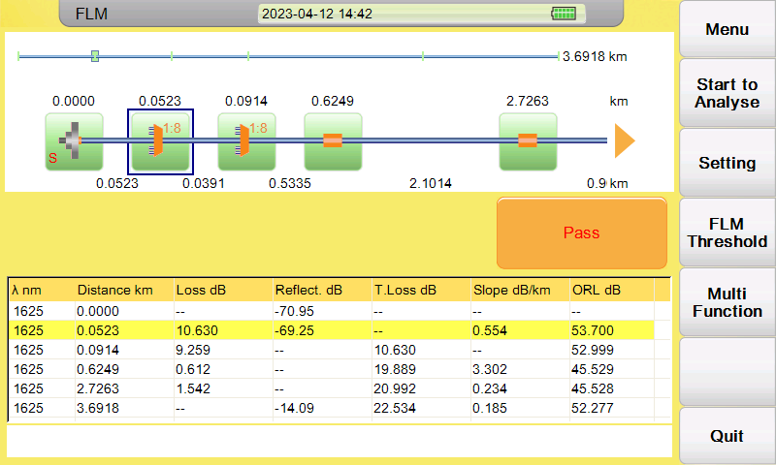
3: FLM performance optimization
Based on improvements in hardware circuits and software, dynamic enhancement, deadzone reduction, resulting in a comprehensive improvement in FLM(fiber link map) testing performance
A : More precise FLM testing performance, shorter 30m PON deadzone when testing non reflective splitter link
B : Maximum can test through 1x128 splitter， for example 1x16+1x8 splitter
✔
1x8
1x8
Min 30m
✔
1x16
1x4
Min 80m
✔
1x16
1x8
Min 80m

Slide 9
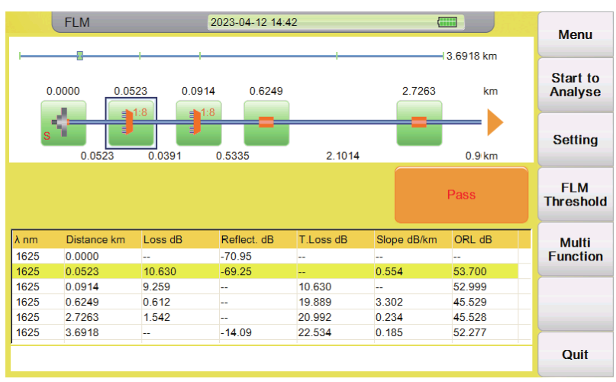
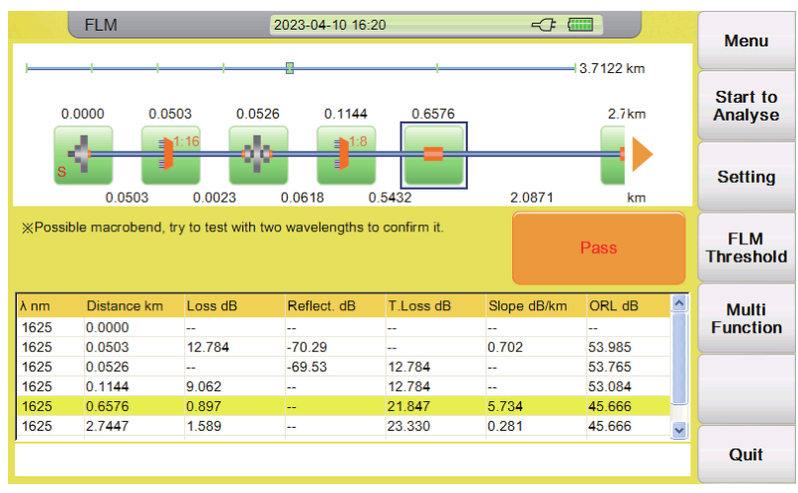
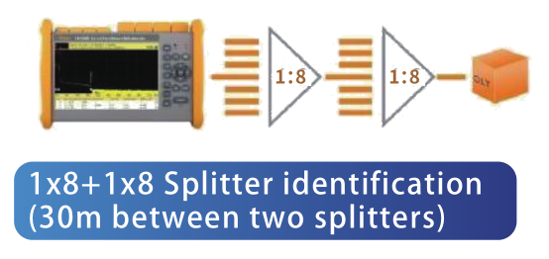
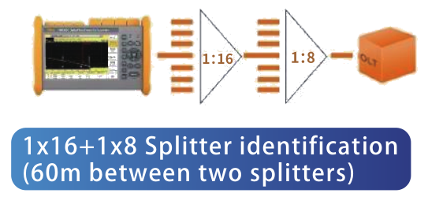
3: FLM performance optimization
FLM PON testing Sample: Two ratios splitter

Slide 10
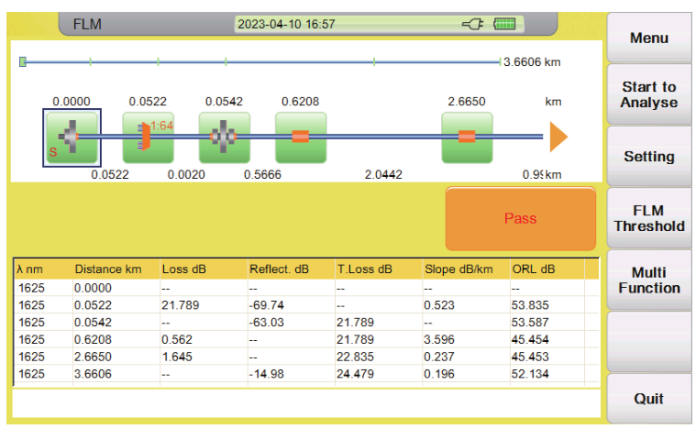
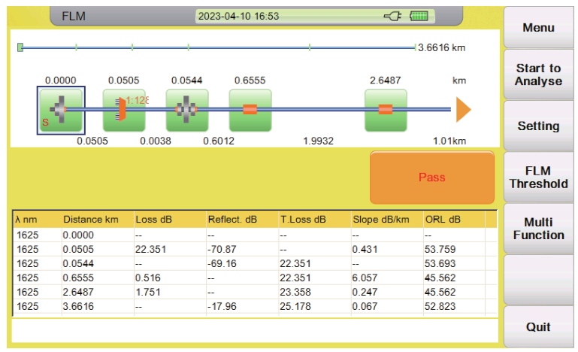
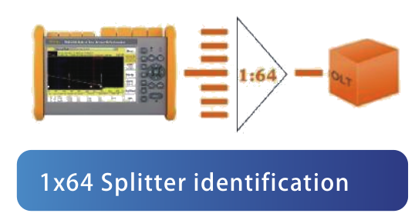
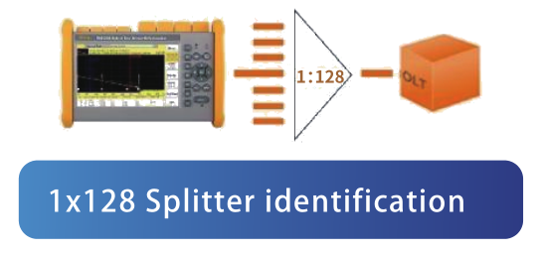
3: FLM performance optimization
FLM PON testing Sample: One ratio splitter

Slide 11
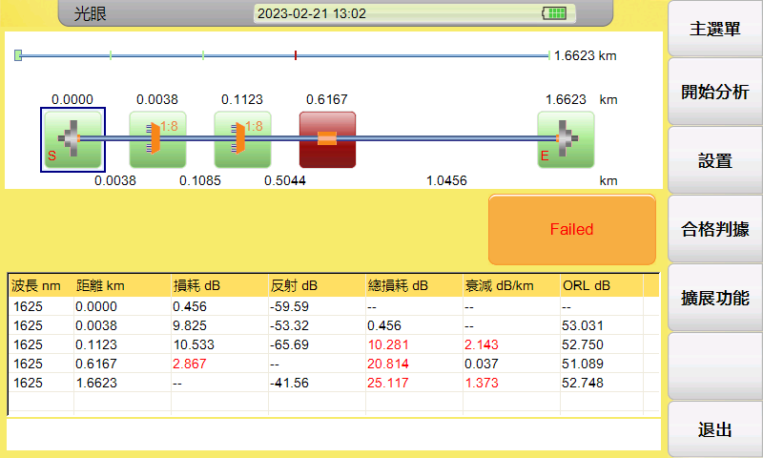
3: FLM performance optimization
FHO5000-T40F/T43F/T45F PRO added built-in optical fiber (about 30m) which enable it can test splitter directly without connecting launch cable

Slide 12
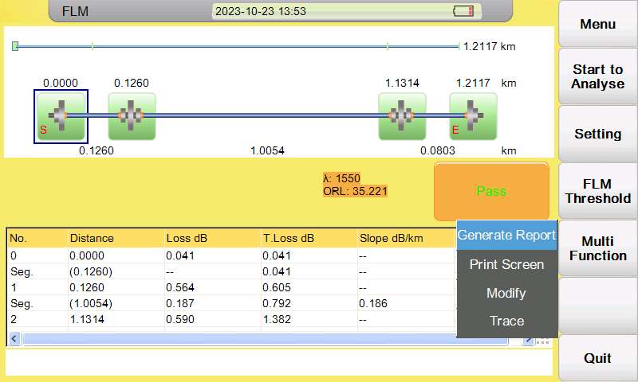
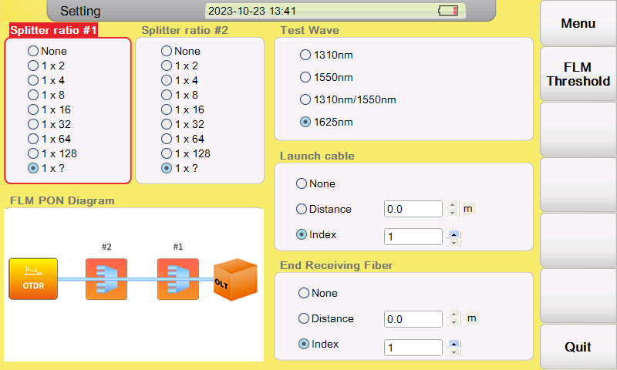
3: FLM performance optimization
A：The new version added a new testing mode: 1x? When the splitting ratio of the splitter is unknown, the user can choose 1x? test mode
B：launch fiber and end receiving fiber can be set
C：Add FLM PON diagram
Some new function
1: Generate FLM PDF report
2: Print screen as bmp format
3: Modify wrong fiber event
4: Convert to OTDR trace
FLM Setting Interface

Slide 13
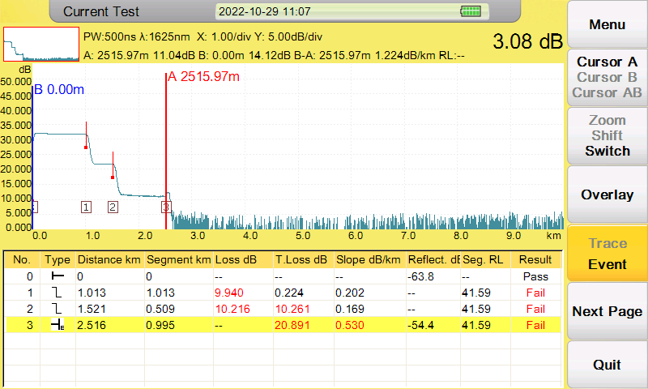
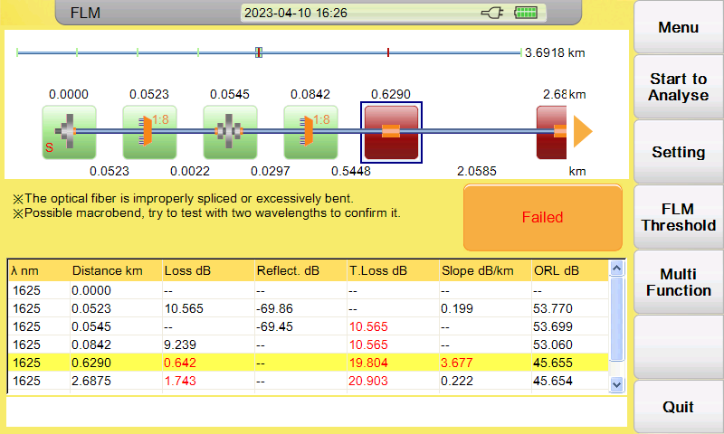
4、New functions
The OTDR curve mode and FLM test mode support the judgment of Pass/Fail function, and the FLM mode also has fault diagnosis analysis
OTDR trace mode
FLM testing mode

Slide 14
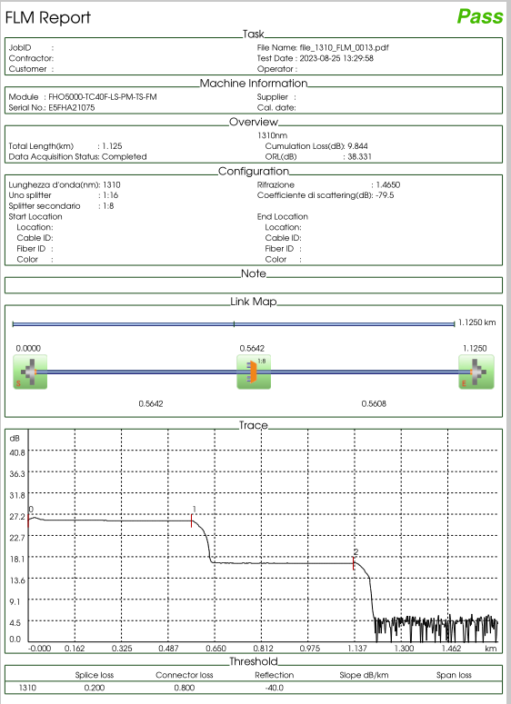
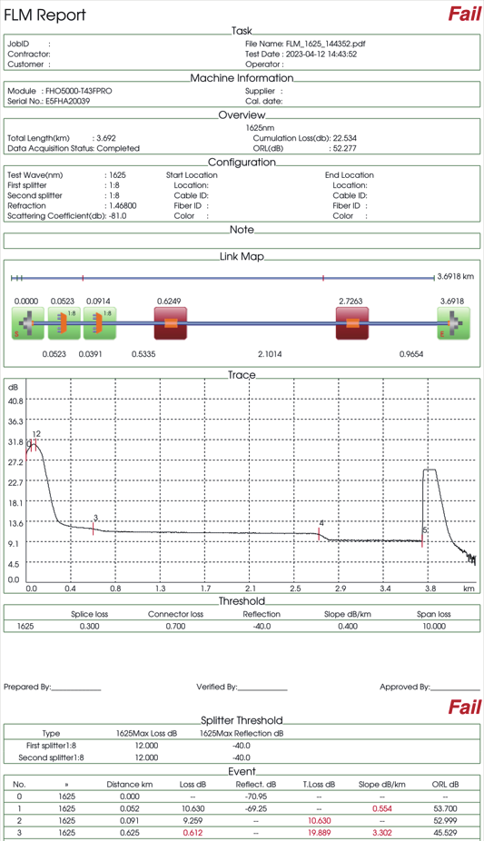
4、New functions
PRO version can directly generate OTDR PDF reports and FLM PDF reports without the need for computer software to generate reports

Slide 15
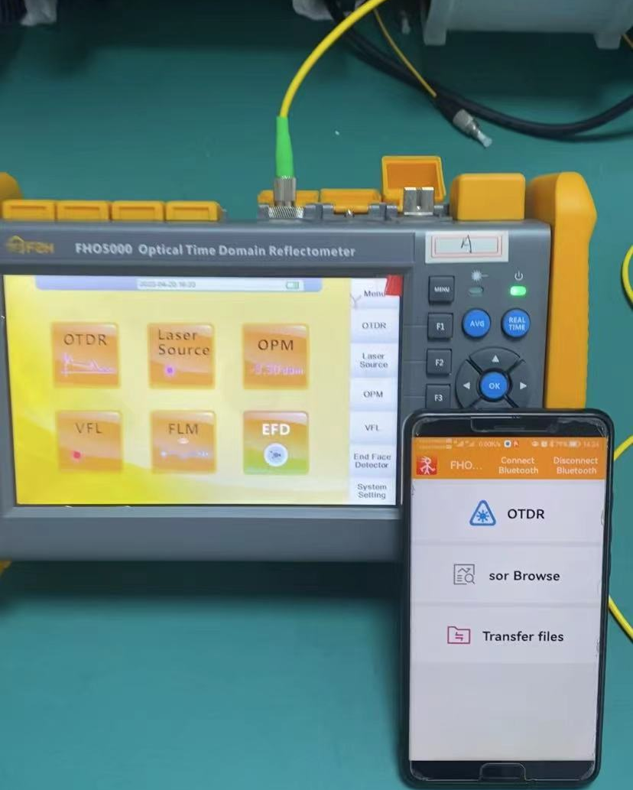
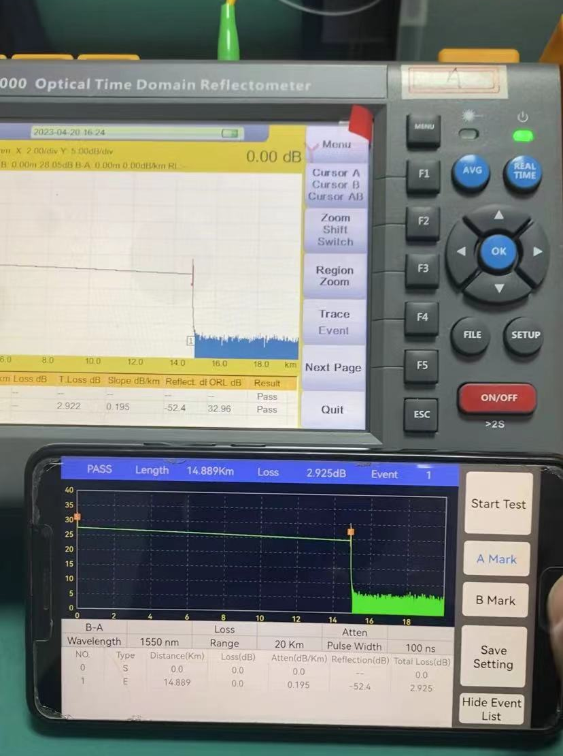
4、New functions
FHO5000 PRO support bluetooth and android mobile phone app

Slide 16
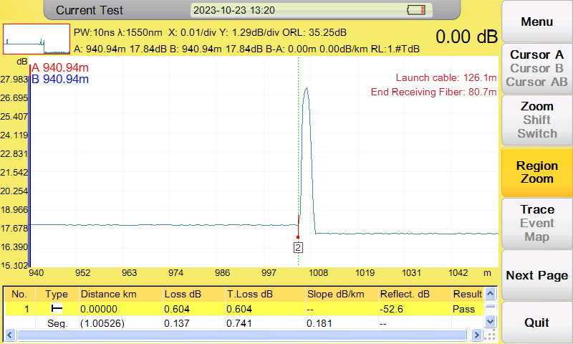
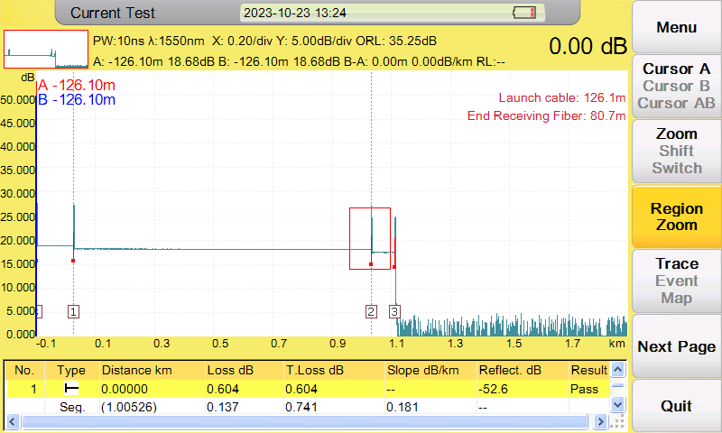
4、New functions
Gestures region zoom
After ZOOM
Before ZOOM

Slide 17
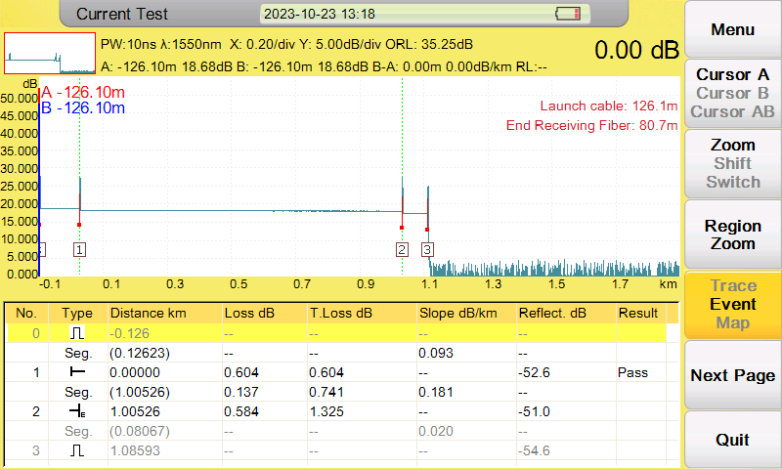
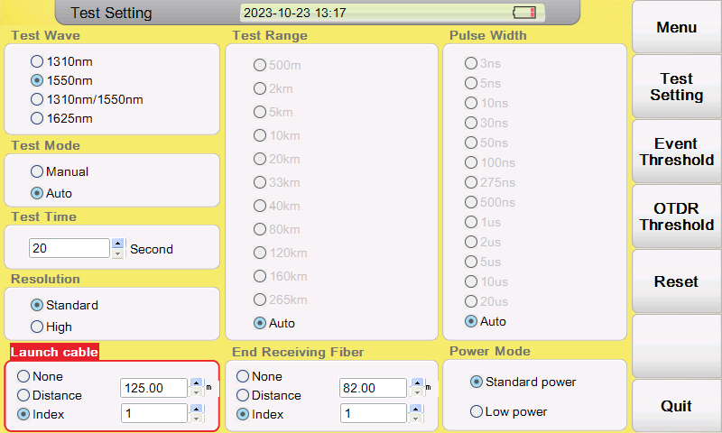
Launch Cable function
4、New functions
1：Add end receiving fiber setting
2：there are two mode to set the start launch fiber and end receiving fiber
a： according to the pre-set fiber length
b：according to the event number
The middle part of the green dashed line is the actual line part

Slide 18
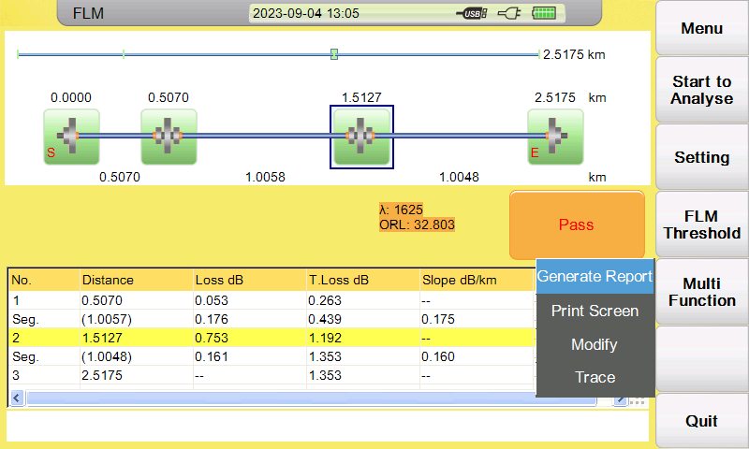
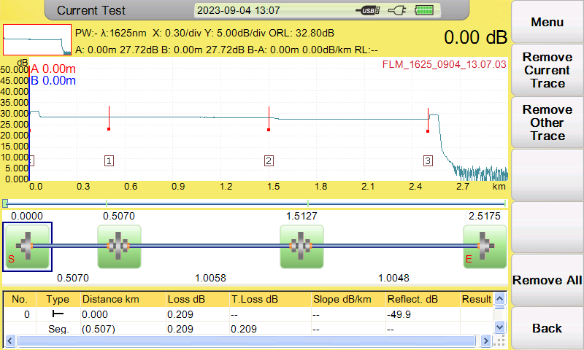
4、New functions
Conversion of OTDR trace and Fiber link map
1: On the FLM testing interface, click trace to open the OTDR trace
2: OTDR trace and event map can displayed on the same screen together

Slide 19
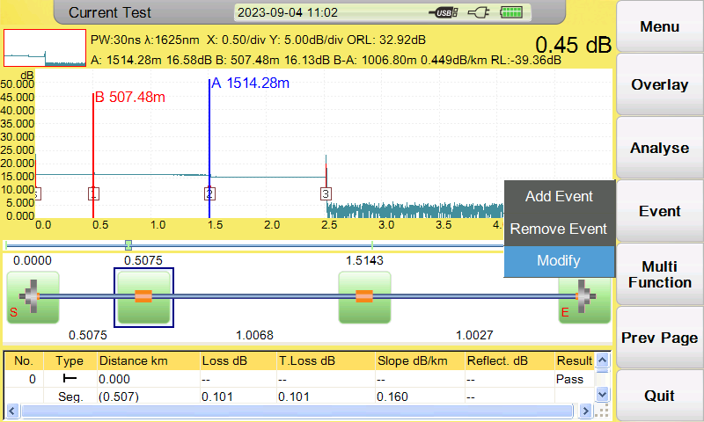
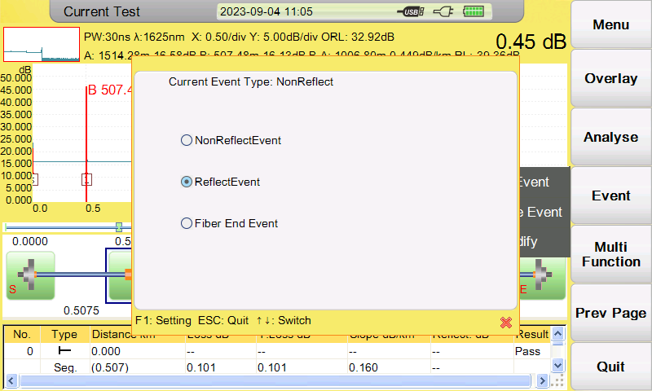
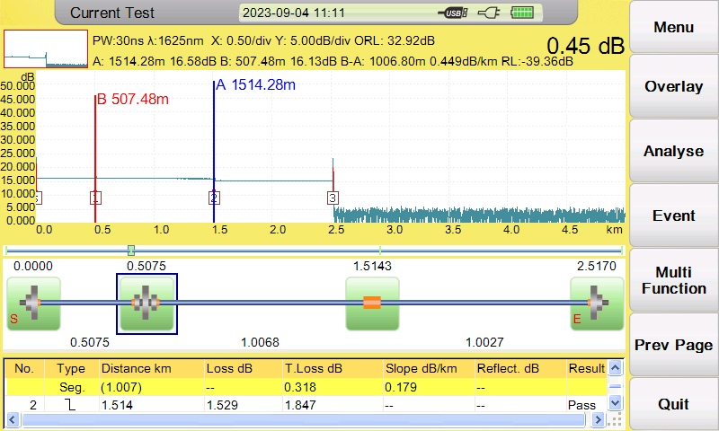
4、New functions
Modify wrong event type in OTDR trace mode
Sometimes the reflection of APC connections is very low, and OTDR may think it is a fusion point as non-reflection event.

Slide 20
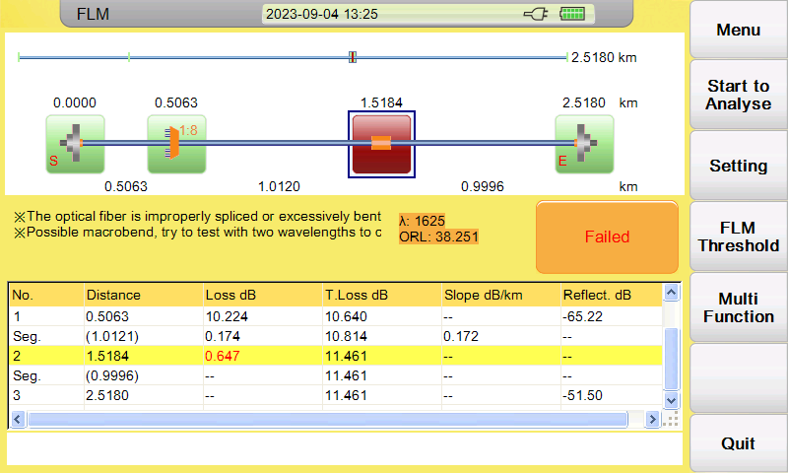
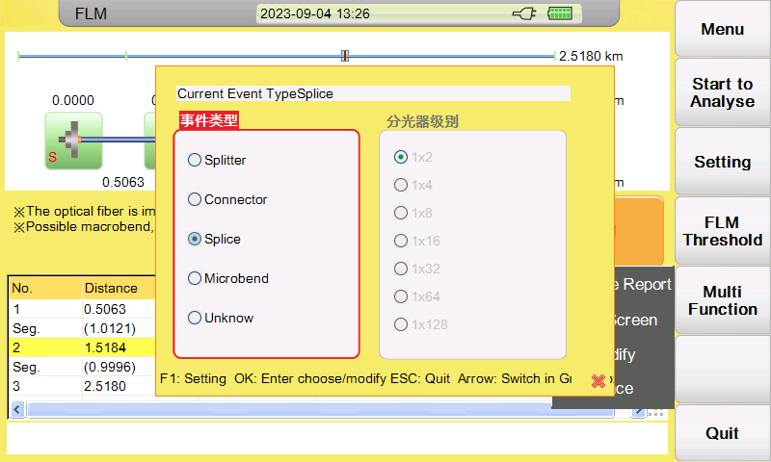
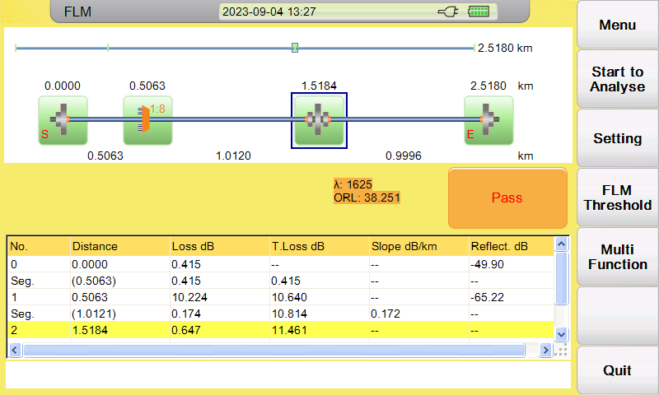
4、New functions
Modify wrong event type in FLM test mode
Sometimes the reflection of APC connections is very low, and OTDR may think it is a fusion point as non-reflection event.

Slide 21
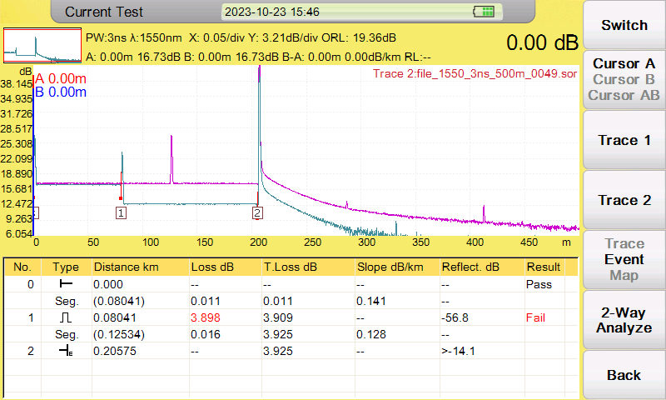
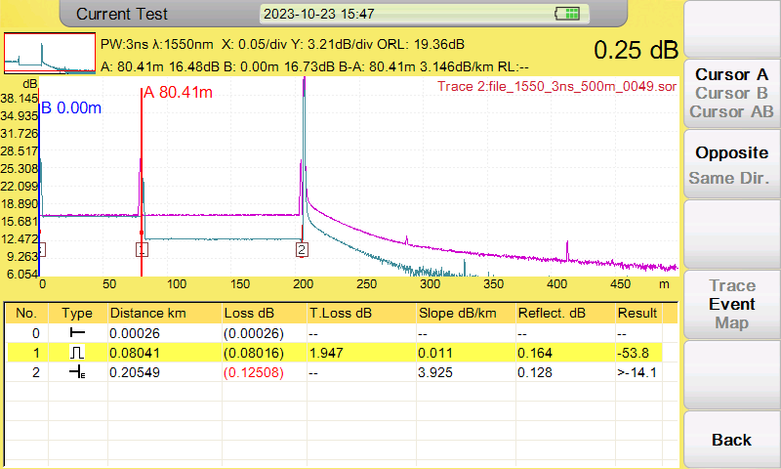
4、New functions
Bidirectional analysis function
Load the measurement results of a fiber link from both directions and perform analysis

Slide 22
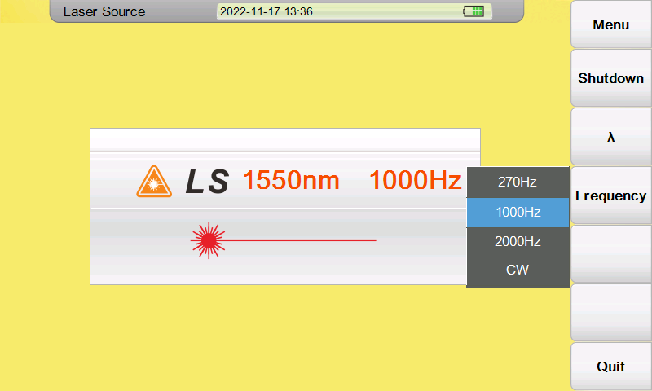
4、New functions
OLS PART： The laser source has added a modulation frequency output mode

Slide 23
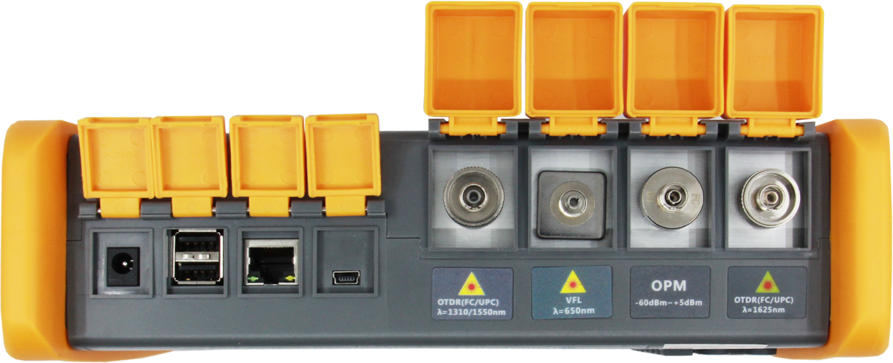
5: others
Change of optical port sequence
from left to right
optical 1310/1550nm port--VFL--OPM-- optical 1625nm port with filter
MM 850nm/1300nm port

Slide 24
Thanks
Let’s go in the Grandway !

